Slide 1


NEAR FIELD COMMUNICATIONS
THE NON-RADIO BITS
Tom Keetch
DC4420, Tuesday 24th June 2014

Slide 2
Who Am I?
Tom Keetch
Security Researcher for BlackBerry
Interested in:
OS Security
Exploit Mitigation (esp. Sandboxes)
Browser / web app security.
Recently: FPGAs…
Notes:
Recently been playing around with LTC mining using FPGAs, interested in chatting to people about that.
This presentation is based on experiences during the development of BlackBerry OS 10 over the past 2 years.
There are some restrictions on what I can say. E.g. no dropping 0h day, my employer wouldn’t be keen on that.

Slide 3
Outline
NFC Re-cap
Tags
Operating Modes
Secure Element
Host-based Card Emulation
Conclusions
Notes:
Premise: There’s more to NFC than just radio, focus on secure element security.
45mins – 1 hr. Can take questions at any point.

Slide 4
NFC RE-CAP

Slide 5

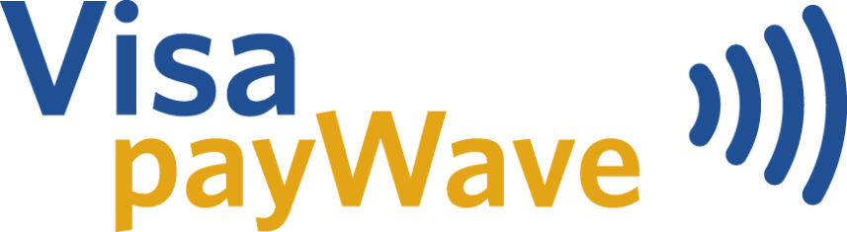

What is NFC?
Near Field Communication
Short Range Communication
Typically 0-5 cm
Specialized antennae will test this assumption
Transaction initiated by a “tap”, signals intent
Used in contactless payments, transport
Was fashionable for security research circa 2012
Notes:
Tony did an introductory talk on NFC a few months ago, but here’s a quick refresher on NFC.

Slide 6
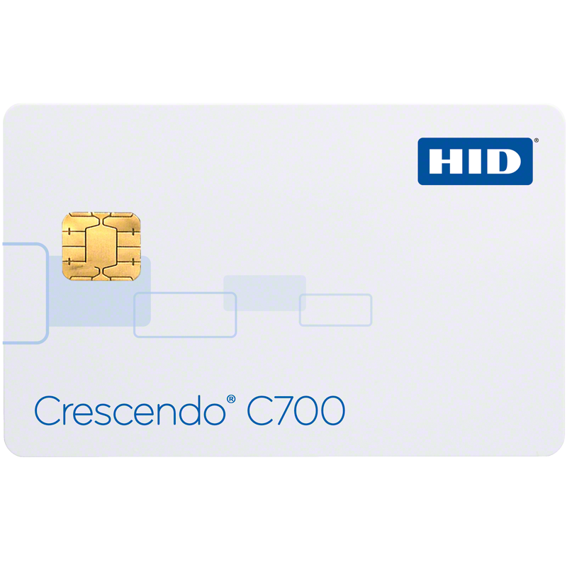
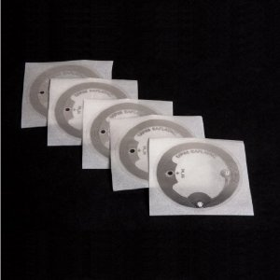
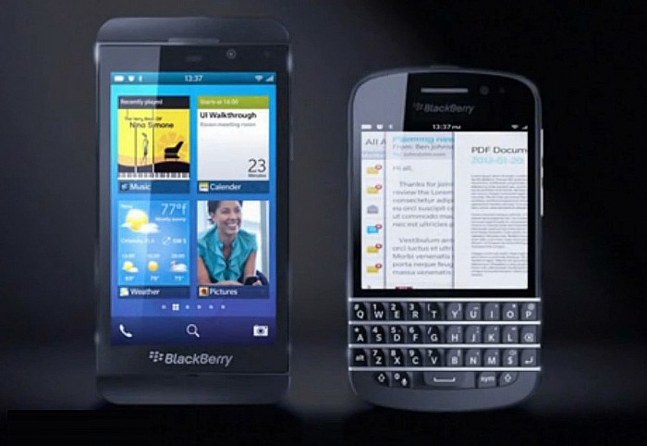
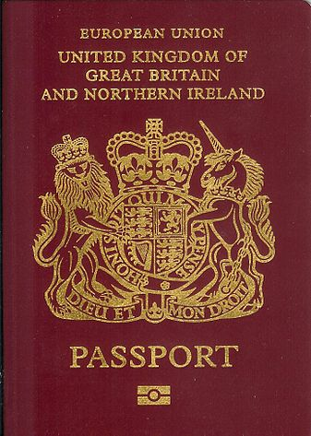
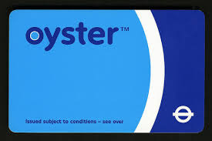
NFC Form Factors
Notes:
Tags – store a small about of data and spit it out when charged by a reader
Smart cards – new contactless interface added e.g. building access cards and bank debit cards
ICAO Passports - as someone pointed out to me recently, Electronic Passports use standard NFC as opposed to a proprietary RFID.
How these work is that certain machine readable data inside the passport is used to authenticate over NFC and then read the full passport contents.
The problem is that the machine readable data is somewhat predictable e.g. date of birth and vulnerable to brute force.
Oyster cards – Pretty much everyone here (in London) will have one.
Mobile Phones – Implement a superset of everything else…

Slide 7
NFC vs. RFID
125kHz
P2P
Tag Read/Write
134.2kHz
NDEF
Card Emulation
433 MHz
2.45GHz
13.56MHz
Global Platform
5.8GHz
Notes:
NFC is continued evolution of RFID technology. Lots of proprietary RFID solutions that can now be implemented in an “NFC-compliant” way.
RFID provides the physical and transport layers for NFC.

Slide 8


Effective NFC Range
~1.5m
~15m
Mallory
Eve
Bob
Eve
Data Source: Renaud Lifchitz, HES 2012 [1]
Notes:
Since limited range is a security property of NFC, the maximum effective range is very important, here are some figures taken from a 2012 presentation.
Eve is a passive attacker, trying to snoop on the (unencrypted) NFC/RFID transaction.
Mallory is an active attacker trying to solicit an NFC “tap” from the card.
Ranges taken from http://2012.hackitoergosum.org/blog/wp-content/uploads/2012/04/HES-2012-rlifchitz-contactless-payments-insecurity.pdf
It’s interesting to consider the relative cost of the equipement vs. the value of the NFC transaction. In the case of contactless payments, the maximum transaction is ~£25, so using £2000 worth of equipment and getting that close probably isn’t economically viable for an attacker. But attacks only get better…

Slide 9
NFC TAGS

Slide 10
TAG Types
There are 4 standardised Tag Types - Why 4?
Conflicting implementations – standardise them all!
Basically
Types 1 & 2 – Simple Low Memory Tags
Type 3 – Japanese Tags (e.g. FeliCa)
Type 4 – Smart Card interface
Type 2 is most commonly used with Mobile Phones
All data encoded in NDEF
Notes:
NDEF = NFC Data Encoding Format

Slide 11
MiFare Classic
The old TfL Oyster cards used MiFare Classic
Not part of the NFC standard
It used proprietary secret cryptographic algorithm...
…which was badly broken (?!!) [2]
Newer Oyster Cards use DESfire – Type 4 NFC cards

Slide 12
Tag Threats
Malformed Tags
Charlie Miller – Exploring the NFC Attack Surface [3]
Malicious Tags
tel://premium-rate-brazillian-phoneline/
Vulnerable 3rd Party URI Handlers
Over-written / replaced tags
Tags in public places might not be write protected
Or might otherwise be physically substituted.
Notes:
Taping a tag or reader is much like clicking a shortened URL in terms of security risks.

Slide 13
NFC Modes

Slide 14
NFC Modes
Reader Mode
Tag/Card Emulation – a device pretends to be a passive device
Peer-to-Peer
Simple NDEF Exchange Protocol (SNEP)
NDEF Based
Logical Link Control Protocol (LLCP)
Connection Based

Slide 15
Handover
If transferring a lot of data, like a large file, NFC isn’t suitable
Therefore NFC supports handover to other transports:
Bluetooth (a.k.a. Android Beam)
WiFi Direct (a.k.a. S-Beam)
Bluetooth LE (?)
Uses tag emulation to present a handover NDEF record
Contains pairing information for temporary pairing
Handover technologies are part of NFC attack surface…

Slide 16
NFC SECURE
ELEMENT

Slide 17
What is the Secure Element?
Fancy name for a Contactless Smart Card
Hosts Applets available over NFC and to local apps
Provides hardware security for applets
A more secure execution environment than commodity hardware
Communication via APDUs over a serial interface
Client asks to speak to an application based on an Application ID (AID)
Communication is Command-Response
Notes:
Applets are the applications that run on the Secure Element / Smart card.

Slide 18
Applets on Secure Element
The Secure Element (on a mobile phone) typicall hosts a number of different applets. For example:
GSM / LTE Applets
Payment Applets
Hardware backed key-storage
The most common Applet Environment is the JavaCard Runtime Environment (JCRE)

Slide 19
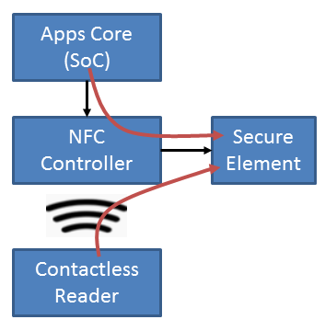
Talking to Applets
Two interfaces
Via baseband processor (contactless)
From apps core
Via /dev/nfc on BB10
Via Binder IPC on Android
An applet can discriminate between the two
Notes:
SoC = System on chip – http://en.wikipedia.org/wiki/System_on_a_chip
The Apps Core refers to where the mobile OS and applications run, as opposed to the modem core / baseband processor.

Slide 20
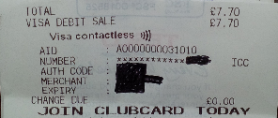
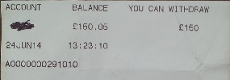
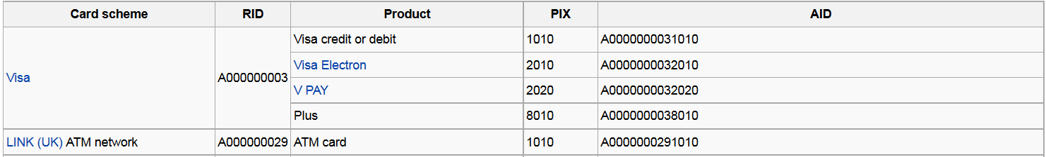
Example: Visa Debit Card
Contactless Payment
ATM Transaction

Slide 21
Types of Secure Element
SIM Card (UICC)
Controlled by Mobile Network Operator (MNO)
Embedded (eSE)
Controlled by hardware vendor
microSD based
Controlled by another third party
E.g. SecuSmart
Host-based Card Emulation – pure software
Notes:
Secusmart uses an SD card for secure Voice – used by German government.
Root of trust is controlled by Germany, not by hardware manufacturer (BlackBerry in Canada) or the MNO.

Slide 22
Control of the Secure Element
A major delay in standardisation and adoption of NFC has been in part due to a tussle between Carriers, Banks and OEMs over control of the Secure Element!
SE Owner can rent space on SE to applet providers.
Everyone wants to control the SE!
Host-based Card Emulation changes this (more later)

Slide 23
Global Platform
The GP standard defines multi-tenant smart-cards
Multiple applets from different parties on a single smart-card
GP version 2.2 designed for mobile devices
SE is divided into isolated compartments called Security Domains
A single Issuer Security Domain (ISD)
Supplementary Security Domains (SSD)
SE applets managed by a Trusted Service Manager (TSM)
Each Security Domain could have a different TSM
Notes:
Global Platform also owns the TEE standard, donated by ARM. But TEE doesn’t support Secure Elements…
More Info: http://www.globalplatform.org/specificationscard.asp

Slide 24
Global Platform (cont.)
TSMs have private encryption keys that allow it manage applets within its associated Security Domain
Different models for how the TSM operates
Simple Mode – Issuer does management on behalf of TSM
Delegated – The SP-TSM has operations authorised by Issuer
Authorised – The SP-TSM can operate independently
Notes:
TSM operations sometimes referred to as Card Content Management (CCM)

Slide 25
SECURE ELEMENT ACCESS CONTROL

Slide 26
Secure Element Access Control
Access Control Files (ACF)
Authenticate Mobile Applications
Secure Channel Protocol (SCP)
Authenticate Trusted Service Managers (TSM)
Contactless Registry Service (CRS)
Authenticate NFC Readers
Notes:
TSM operations sometimes referred to as Card Content Management (CCM)

Slide 27
Contactless Reader
SCP
SP-TSM
CRS
Secure Element
Issuer Security Domain
Supplementary Security Domain
Supplementary Security Domain
Root TSM
Applet A
Applet D
Applet C
SP-TSM
Applet B
Applet E
ACF
Device
App 1
App 2
App 3

Slide 28
Access Control File
Steps:
Check caller is allowed to access the applet
If allowed: open a new logical channel
SELECT the requested Applet ID (AID)
Pass open channel to the client application
However, the OS needs to filter out certain types of APDU
Otherwise, the client application can select a new applet, bypassing the access control.

Slide 29
Secure Element
Issuer Security Domain
Supplementary Security Domain
Supplementary Security Domain
Applet A
Applet D
Applet C
Applet B
Applet E
ACF
Device
App 1
App 2
App 3

Slide 30
Access Control File (cont.)
Controls which applications can access which applets on the secure element
Signature based
Implemented/Enforced by the platform
Only applies to user-installed mobile applications
E.g. Remove the SIM and place in a reader, ACF not enforced
Could be bypassed by rooting the device
Other mechanisms can be used to access SE

Slide 31
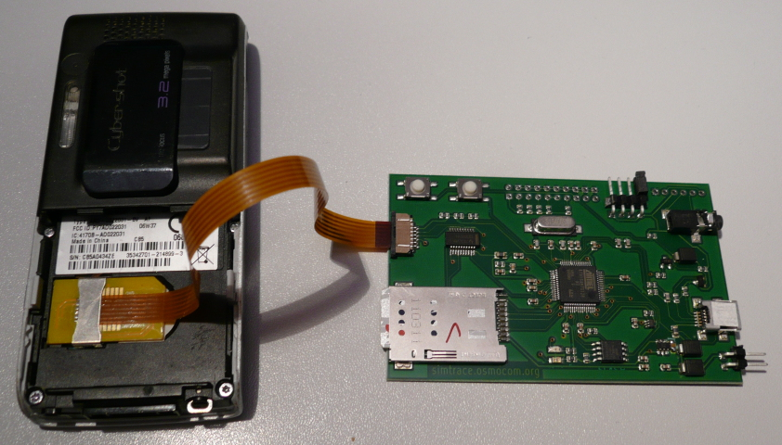
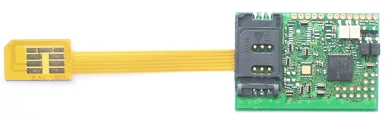
SIM Traffic Interception Tools
Osmocom SIMtrace - €90
Bladox Turbo Lite 2 - €49
Notes:
Two Options… I’ve not personally used these, so I can’t recommend them, but others have had success.
1) Osmocom SIMtrace
Costs €90.
http://bb.osmocom.org/trac/wiki/SIMtrace
Can do passive snooping; MITM is possible, but not implemented (AFAIK).
2) Bladox Turbo Lite 2
Costs €49.
http://www.bladox.com/prod_lite_2.php

Slide 32
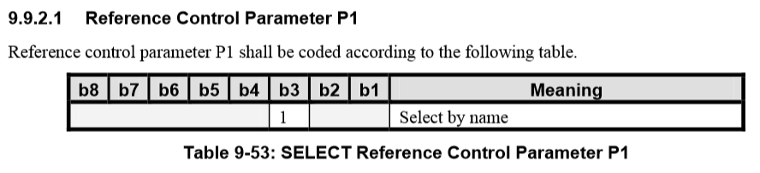
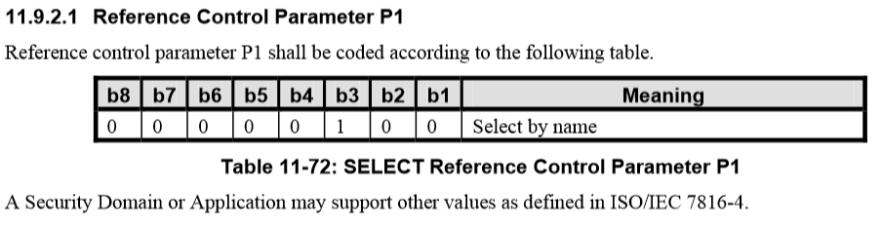
Access Control Ambiguity
Notes:
This shows the encoding of a filtered APDU in different versions of the standard.
Not clear if it’s a flag or an absolute value, but getting it wrong completely breaks the access control model, since you could slip past a SELECT [by name] APDU that should be filtered.
There were two of these checks in the BB10 codebase, both treated it a different way (one as a flag, the other as an absolute value).
I can talk about this bug, because it didn’t affect BlackBerry devices and the problem was resolved a good while ago in GP 2.2. It only affected GP 2.1.1, which no mobile device should be using.

Slide 33
Secure Channel Protocol (SCP)
Authenticates the Trusted Service Manager
Creates a secure channel between the TSM and SD
Mutual authentication
TSM needs right keys for the SD it’s accessing
Provides message integrity and sometimes confidentiality
Unique key per Secure Element
Unique key per Security Domain

Slide 34
SCP
SP-TSM
Secure Element
Issuer Security Domain
Supplementary Security Domain
Supplementary Security Domain
Root TSM
Applet A
Applet D
Applet C
SP-TSM
Applet B
Applet E

Slide 35
Secure Channel Protocol (SCP)
Symmetric Key Based (Global Platform)
SCP01: Deprecated
SCP02: 3DES-based
SCP03: AES-based
PKI Based (Global Platform)
SCP10: RSA Certificates
SCP11: ECC Certificates
OTA Based (ETSI)
SCP80: SMS
SCP81: Connection-based
Notes:
SCP02 is most common, smart cards are low power and must resist a wide range of physical and side-channel attacks.
Therefore symmetric crypto is preferred.

Slide 36
Rooting SIM Cards – Karsten Nohl [5]
Attacking legacy SMS OTA
Very similar to newer SCP80 standard
Each SMS is like an APDU
Many SIM Cards use Single-Key Triple DES
Cracked using Rainbow tables
Used to install a malicious applet OTA
SIM Cards are slow – motivation to use fast symmetric algorithms
Able to gain “root” on smart card

Slide 37
Contactless Registry Service
Manages visibility of applets over the contactless interface
Can be managed directly by user
Each applet has a user-friendly name and icon
Mobile wallet can enable/disable:
Individual applets
NFC card emulation mode (affecting all applets)
Allows a single card to be selected for a mobile payment

Slide 38
Contactless Reader
CRS
Secure Element
Issuer Security Domain
Supplementary Security Domain
Supplementary Security Domain
Applet A
Applet D
Applet C
Applet B
Applet E

Slide 39
HOST CARD EMULATION

Slide 40
Host-based Card Emulation (HCE)
If a Secure Element is unavailable, HCE allows a pure software implementation
Mobile application can implement Applet functionality
This gets around the problem of SE ownership mentioned
Introduced in Android KitKat (4.4)
Now used by Google Wallet, which no longer supports hardware Secure Elements [6]
Header Card
Online transactions only
Notes:
With Host-based Card Emulation, you sacrifice the hardware security provided by the secure element, but you get more flexibility and don’t have to pay any fees to the secure element owner. This opens up many more possibilities for less-sensitive applications, but EMV applets will most likely still want to use a hardware Secure Element.
More info: http://www.nfcworld.com/2013/10/31/326619/google-gets-around-carriers-host-card-emulation-nfc-payments/

Slide 41
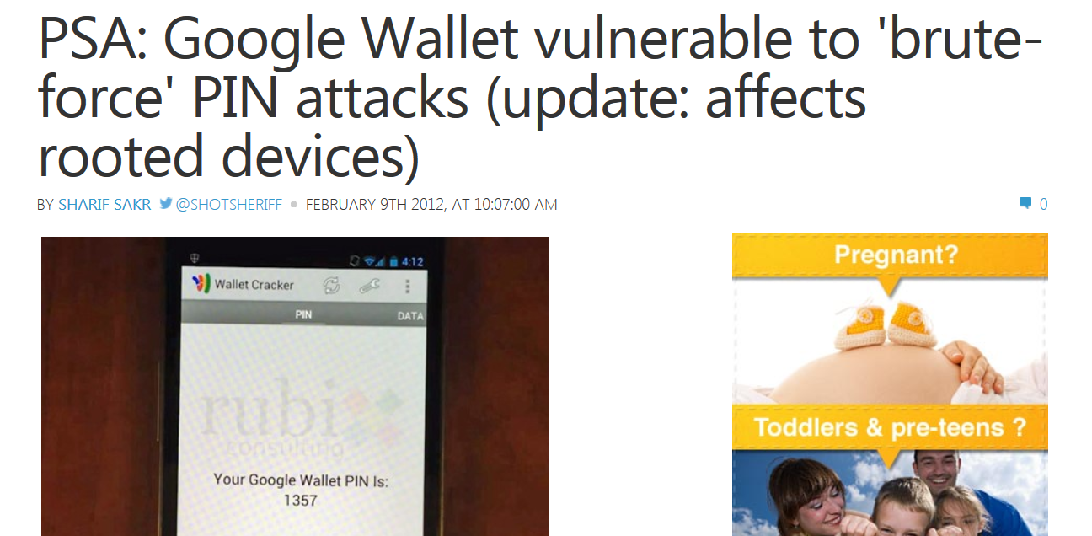
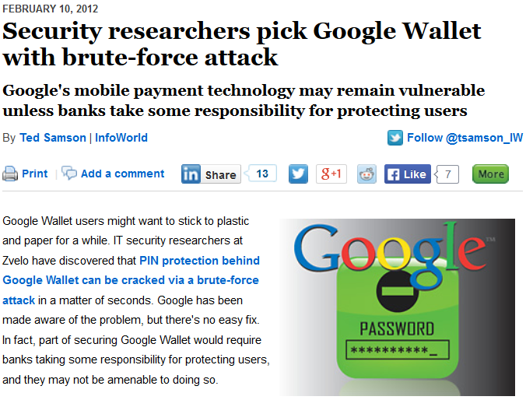
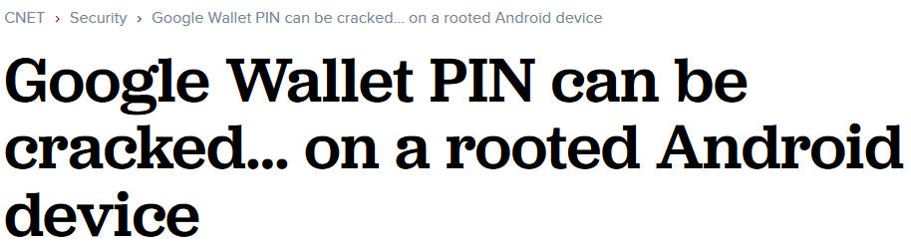
Notes:
The proper way to implement this functionality would have been to do the PIN code check on the secure element, preventing the offline brute force attack. But this would require Google to agree deals with the carriers, since they own and control the secure element.

Slide 42
CONCLUSION

Slide 43
Conclusion
Hopefully a useful introduction to thinking about the security of mobile NFC applications
NFC Security is still evolving
An area with scope for interesting research
Mobile payments still haven’t hit the mainstream
Will they ever?
NFC is still relevant technology in widespread use
Host-based Card Emulation is a game-changer

Slide 44
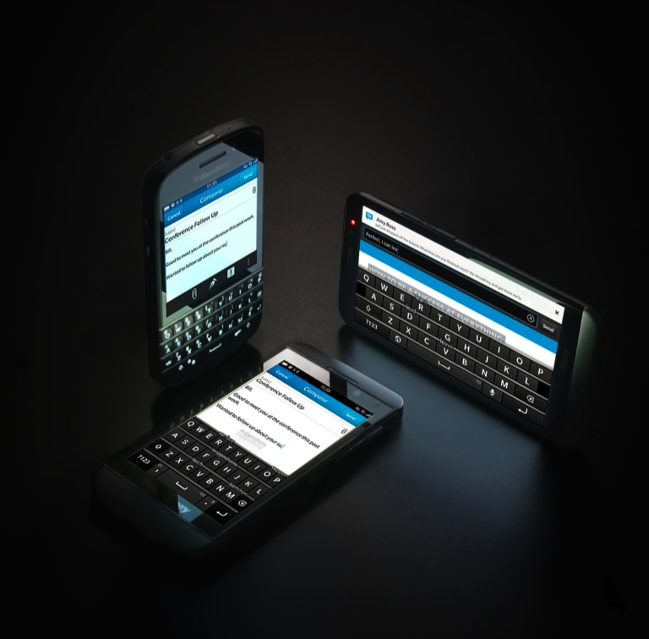
ANY QUESTIONS?
Twitter: @tkeetch
Email: nfc@tkeetch.co.uk

Slide 45
References
[1] http://2012.hackitoergosum.org/blog/wp-content/uploads/2012/04/HES-2012-rlifchitz-contactless-payments-insecurity.pdf
[2] www.doc.ic.ac.uk/~mgv98/MIFARE_files/report.pdf
[3] https://media.blackhat.com/bh-us-12/Briefings/C_Miller/BH_US_12_Miller_NFC_attack_surface_WP.pdf
[4] http://bb.osmocom.org/trac/wiki/SIMtrace
[5] https://media.blackhat.com/us-13/us-13-Nohl-Rooting-SIM-cards-Slides.pdf
[6] http://www.nfcworld.com/2014/03/17/328326/google-wallet-ends-support-physical-secure-elements/
Further Information
Android Explorations Blog - http://nelenkov.blogspot.co.uk/search?q=nfc
Global Platform Standards - http://www.globalplatform.org/specificationscard.asp
Chip & PIN is Broken - http://www.cl.cam.ac.uk/research/security/banking/nopin/oakland10chipbroken.pdf

